Slide 1


Diabetes Datathon
Team 10 – Mellitus
Notes:
Ensure the titles are not duplicated. Please check the set of best practices.

Slide 2
Agenda
03
Team
04
Challenge Statement
05
Introduction
06
High Level Architecture
Finding actionable insights from the Diabetes Data for a Drug Manufacturer Company
07
End State Architecture
08
Data Preprocessing Framework
09
Data Curation & Serving Reports
10
Data Visualisation
11
Advanced Analysis
12
Patient Profiling
13
Analytics and Insights Dashboard
14
Actionable Outcomes
Notes:
We are going to go through the solution, visualize outcomes of analysis, and provide actions for the Drug Manufacturer Company.

Slide 3






Team 10 - Mellitus
ZESHAN
Architect
SAMIA
Data Engineer
ABI
Data Engineer
SAMIHAH
Vis Scientist
STEPHANIE
Project Manager
M&S goes through numerous restructuring programmes and recovery plans
Notes:
This is our team Mellitus.

Slide 4
CHALLENGE STATEMENT
What insights can you derive from the diabetes data?
analyse the impact of diabetes Disease on the human body by performing data analysis and visualisation, to inform the drug manufacturer’s approach.
Notes:
Our aim is to derive the insights from the diabetes data by analysing …

Slide 5


Introduction
Overview
This research explores the relationship between diabetes and potential triggers, including demographic and lifestyle factors. By leveraging statistical analysis and machine learning, the study aims to identify high-risk groups and significant patterns, providing actionable insights to guide targeted interventions, preventive strategies, and drug development.
Problem
Diabetes is a growing global health issue. However, the lack of clarity of the triggers hampers early diagnosis, personalized interventions, and effective prevention strategies.
Action taken – Phase 1
With internal synthetic dataset
Step 1
Data Preprocessing
Step 2
Schema Designing & SQL Queries
Step 3
Data Visualization
Step 4
Document and Present
Approaches
Our client, a drug company, required the team to take advanced data-driven approaches to uncover predictive patterns and high-risk groups, enabling targeted treatment design.
Actions to-do – Phase 2
With external and real patient datasets
Step 5
External & Real dataset
Step 6
Non-Functional Requirements
Notes:
Now we going through the actions we took in the last two weeks. Step one ---, followed by documentation and presenting.
Besides, we are going to take further actions on the external dataset due to the time limitations in phase one research

Slide 6
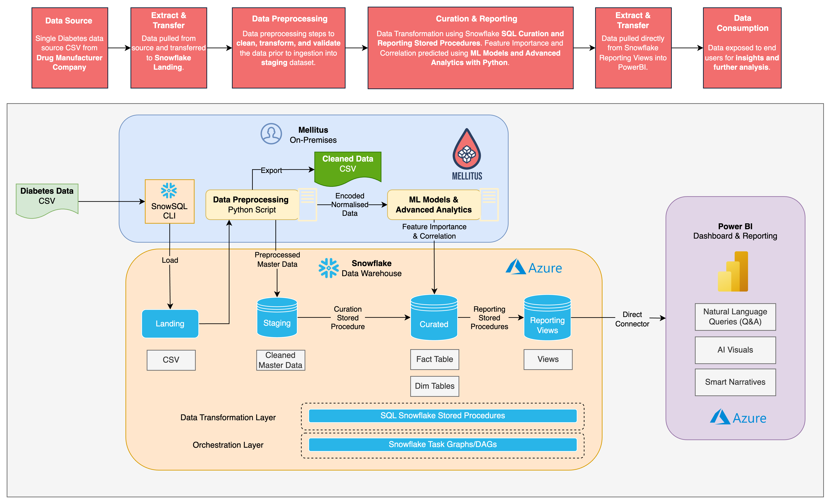
High Level Architecture
Notes:
Zeshan

Slide 7
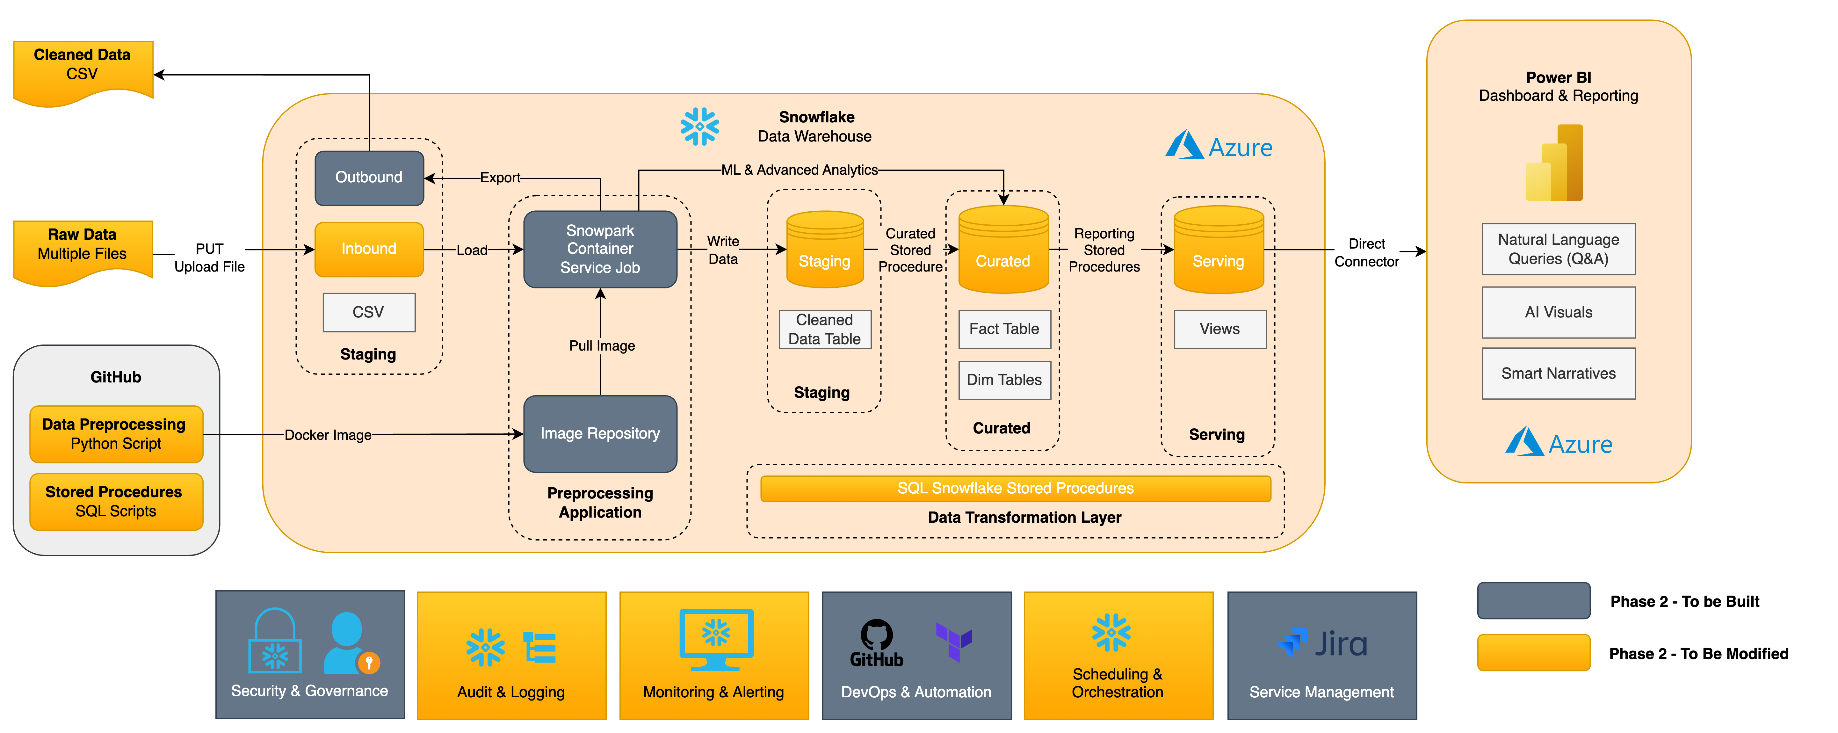
End State Architecture
Notes:
Zeshan – Currently solution is built specific to Diabetes Data, however, we have designed an end date which allows for multiple file sources, preprocessing migrated to Snowflake, and more importantly, brings in more non functional requirements, e.g. Data Privacy policies for PII and real patient health data, to essentially deliver the goal of a holistic E2E diabetes data solution

Slide 8
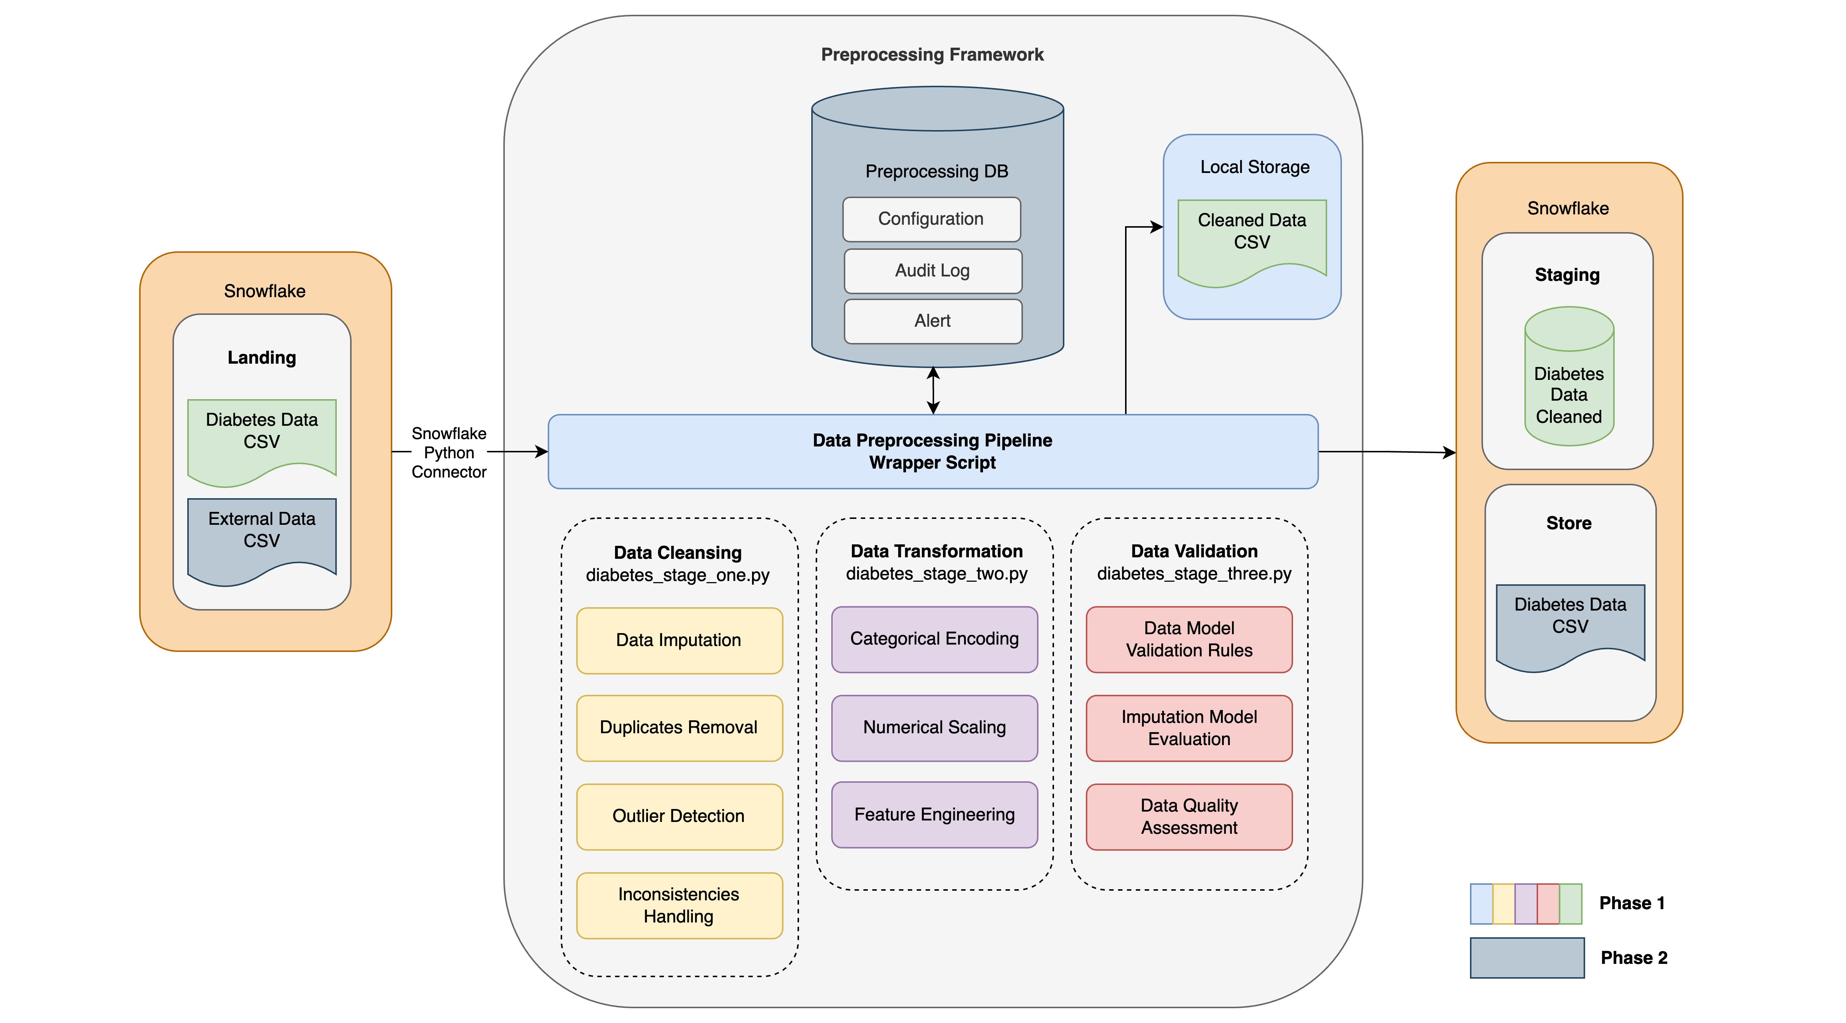
Data Preprocessing Framework
2
Data cleansed, transformed and validated
3
Cleaned data exported
1
Data Landing in Snowflake
Notes:
Zeshan

Slide 9
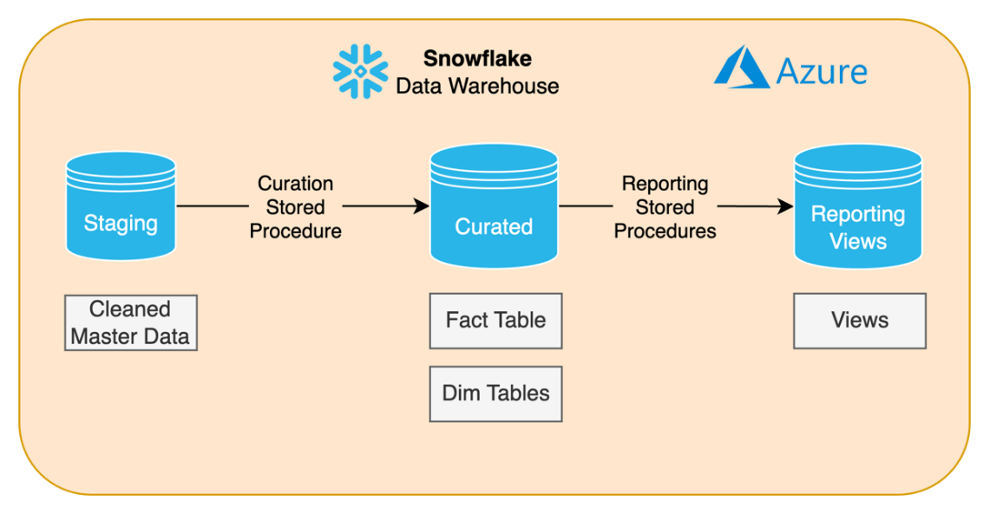
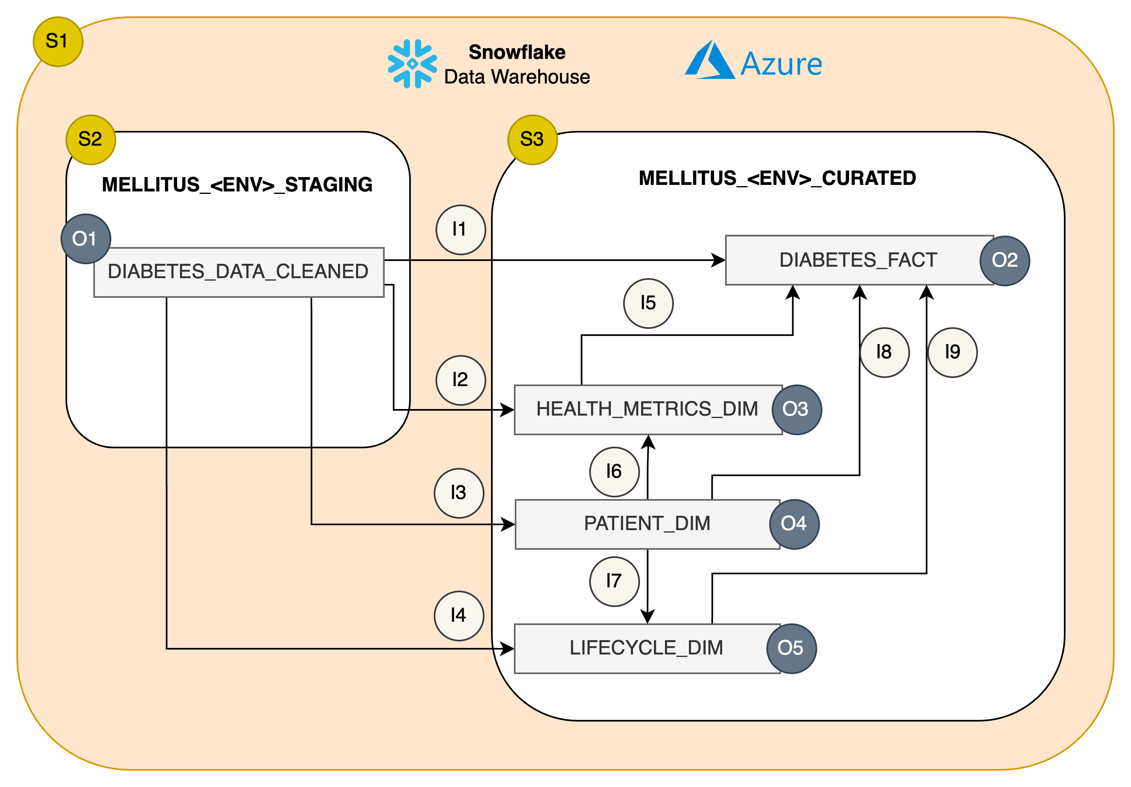
Data Curation & Serving Reports
3
Data aggregated for reporting views using reporting stored procedures
1
Cleaned Data in Snowflake Staging
High Level
Data Architecture
2
Data transformed to Star schema using curated stored procedures
Curated database: Star schema with central fact table with descriptive dimension tables.
Serving database: Views providing valuable insights for lifestyle, health management and prevention of diabetes.
Data Flow Diagram – Curated
Notes:
Samia
The cleaned data is then loaded into the staging database on snowflake
Using curated stored procedures, we created a star schema-consisting of a central fact table and descriptive dimension tables
Using reporting stored procedures, views are created-which focus on various lifestyle/health metrics looking at things like diet type, BMI, alcohol consumption-and how they link to the prevalence of diabetes.

Slide 10
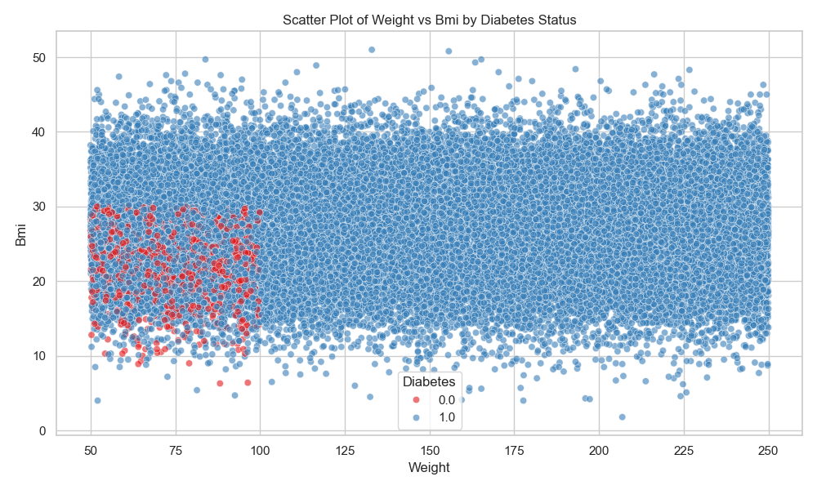
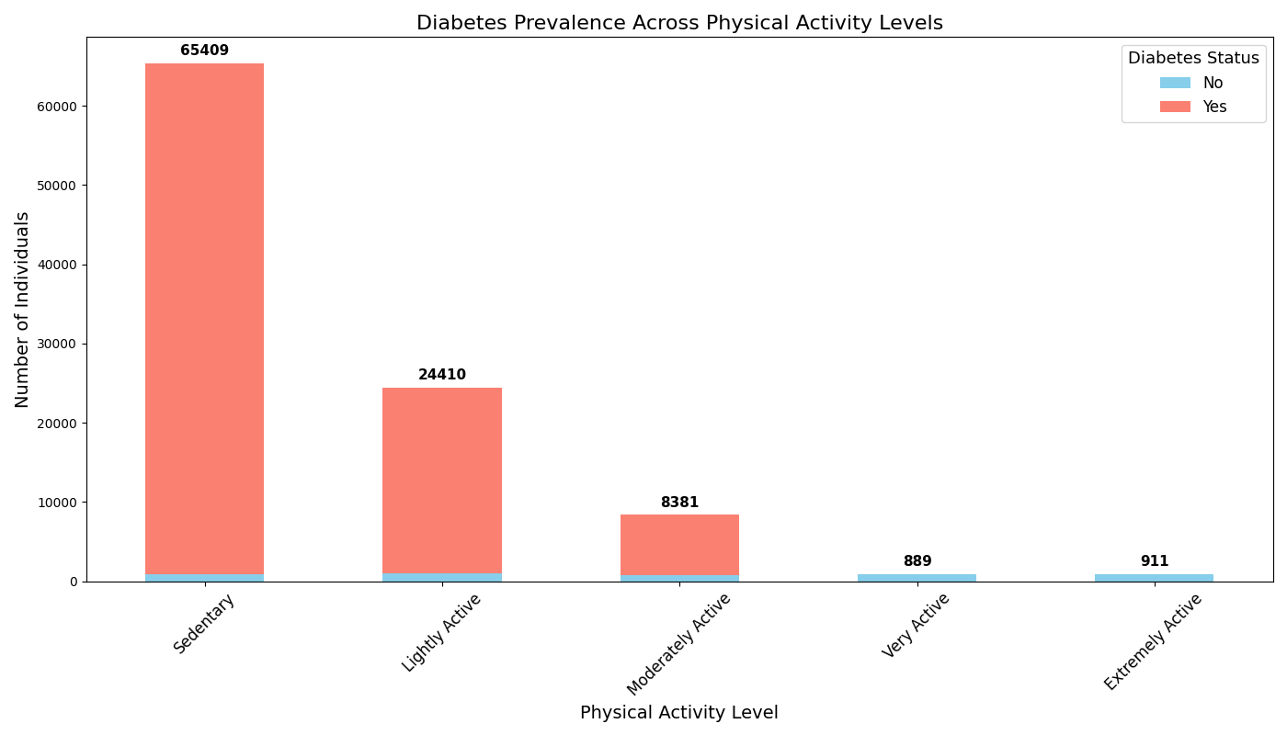
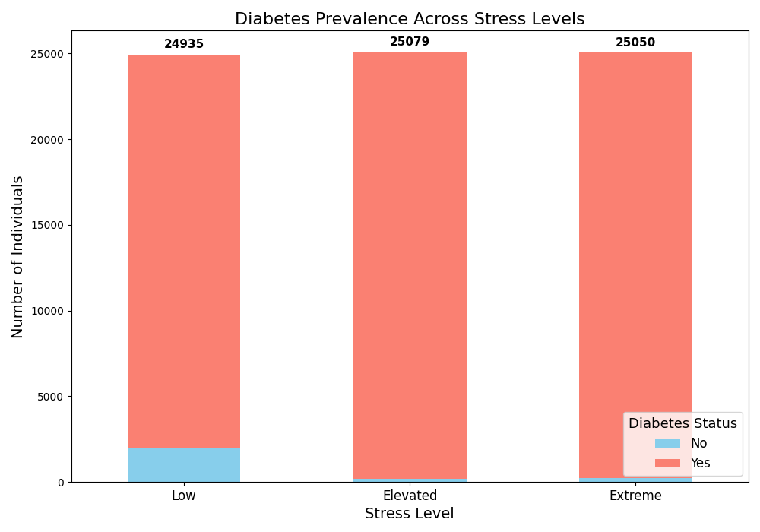
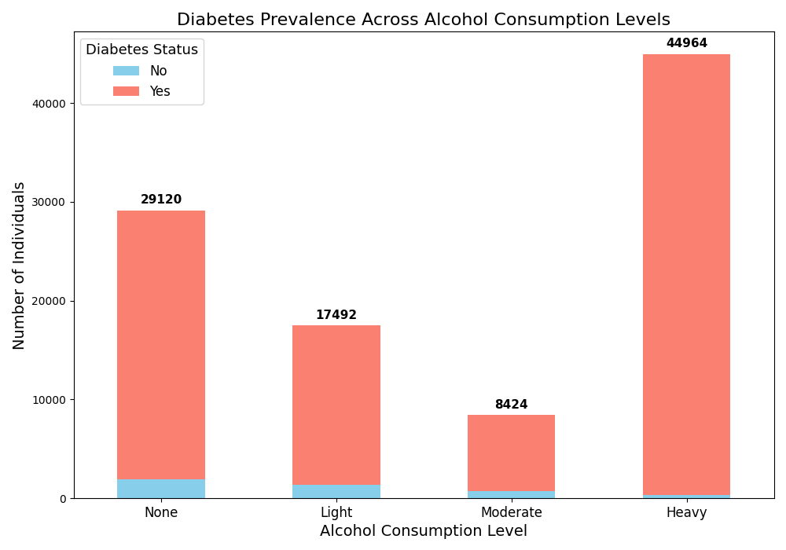
Data Visualisation
Notes:
Samia
Here are some initial visualisations based on the aggregated views.
For high levels of physical activity-we see no diabetes
Top right-shows weight vs BMI:Cluster defined by weight less than 100, BMI less than 30. Shows low cases of diabetes.
Bottom two shows ratio
Ratio of diabetes to alcohol consumption level is much higher with a higher alcohol consumption level
Ratio of diabetes to srress level: with higher stress levels, diabetes prevalence is higher

Slide 11
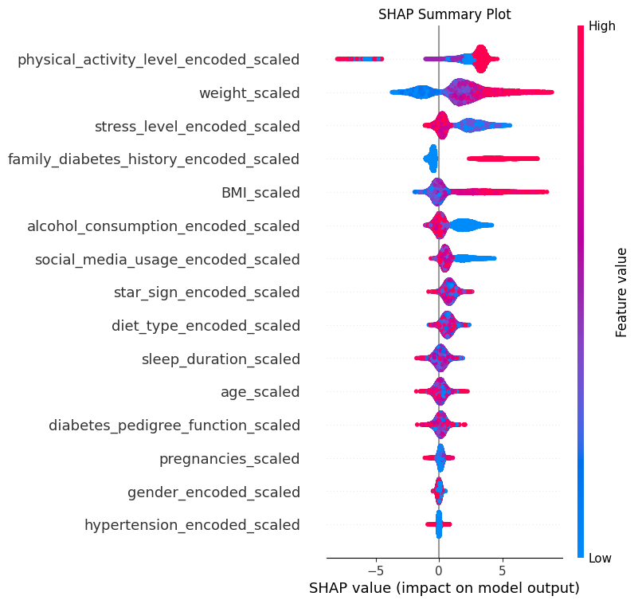
Advanced Analysis
Machine Learning Models
The following six variables were identified as most important Diabetes Predictors across the top 5 of all 3 models evaluated, including Logistic Regression, Random Forest, and XGBoost.
1
Physical Activity
High activity reduces risk; low activity increases it
2
Weight
Higher weight raises risk; lower weight lowers it
3
Stress
High stress raises risk; low stress lowers it.
4
Family Diabetes History
Diabetes history strongly raises risk.
5
BMI
Higher BMI raises risk significantly.
6
Alcohol Consumption
High intake raises risk; low intake lowers it
Notes:
The Analysis involved evaluating 3 Machine Learning Models, that is logical Regression, Random Forest and XGBoost. Across all 3 models, 6 key variables consistently emerged as the most significant predictors of Diabetes Risk. The left hand side identifies the 6 variables, along with brief insights into their influence on diabetes. On the right side is a SHAP summary plot that explains the XG boosy model. that explains

Slide 12


Patient Profiling
Feature | Diabetic | Non-Diabetic
Physical Activity | Sedentary, Light or Moderate Activity | Very Active or Extremely Active
Weight | > 100 KG | < 100 KG
Stress | Elevated or Extreme | Low
Diabetes Family History | Y | N
BMI | > 30 (Obese) | < 30 (Overweight, Normal and Underweight)
Alcohol Consumption | Heavy | None, Low, or Moderate
Highest
Relative Importance
Lowest
Notes:
Abi

Slide 13
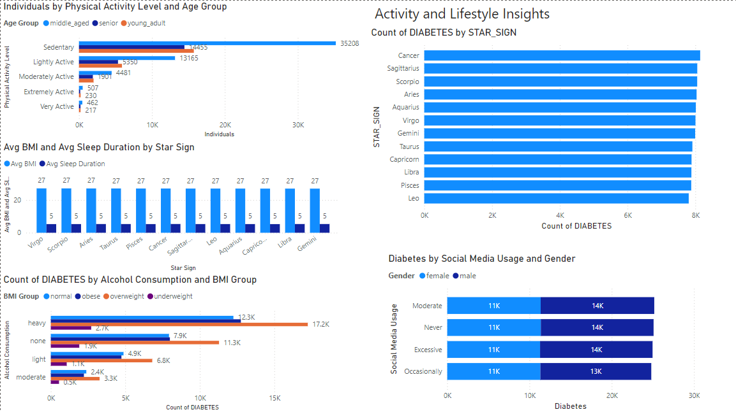
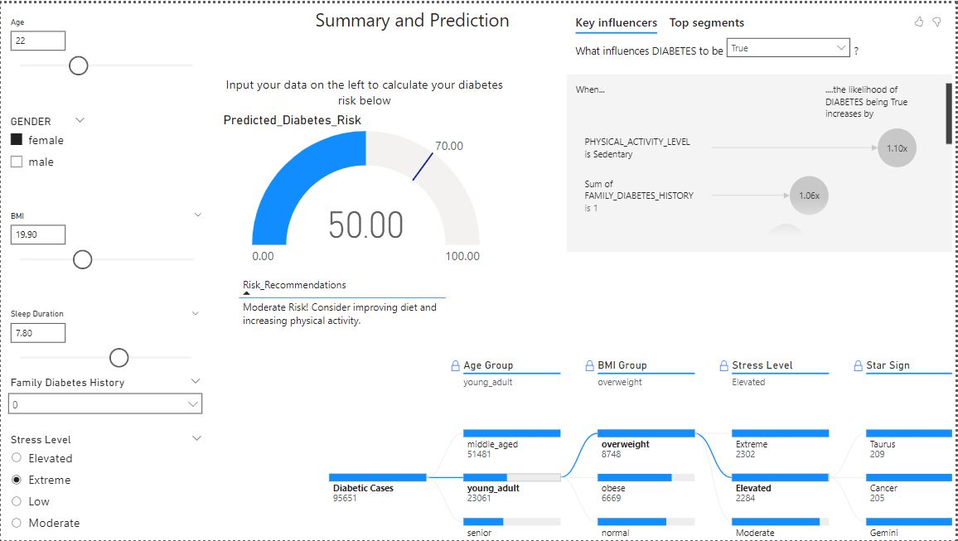
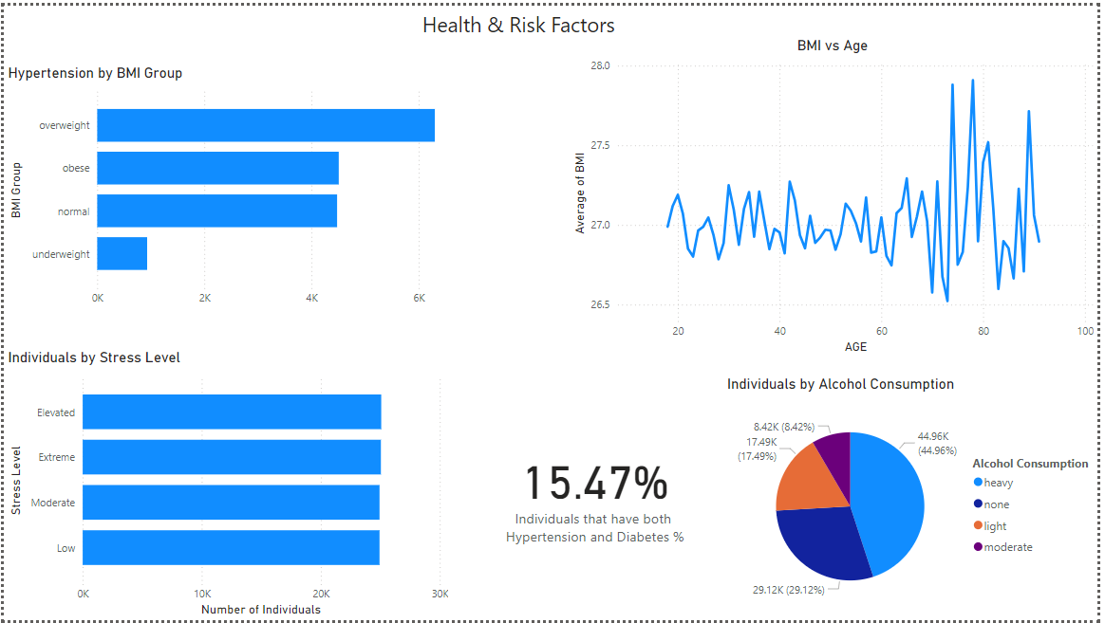
Analytics & Insights Dashboard
Notes:
Hi Everyone, so we have created a comprehensive dashboard, so and broken them into different sections an overview, health metrics, demographics. And then our last page, we have created an interactive page where from all of the analysis using AI visuals, you can predict your own risk of diabetes, which can change depending on what factors you select, and get feedback on what to improve.
In terms of the patients, we have determined that specific to the analysis we have done,
Diabetes affects all age groups but is most predominant in middle-aged patients (45–64 years). And then,
Having family history of diabetes also greatly contributes to the risk, with 24% of cases being linked to genetics.
So what are the impacts all these can have on the body? So:
High BMI, combined with diabetes increases the risk of heart disease or strokes.
Diabetes leads to conditions in the eyes like cataracts, glaucoma, which can lead to vision loss.
And finally, diabetes is also associated with higher rates of depression and anxiety.

Slide 14




The Data Insights of Diabetes
WHAT ARE THE ACTIONABLE OUTCOMES?
Personalised Medication Development and Recovery Plans
Enhanced Clinical
Drug Trials
Based on patient profile, tailor the medicine and recovery plan to suit needs of the patient.
Actions:
Personalised Weight and Metabolic Agent Medications
Diabetes related disease medication development
Targeted Stress-Reduction Therapies
Targeted Alcohol Recovery Plans
Market Segmentation and
Personalised Marketing
Enhance the outcome of clinical drug trials by selecting appropriate target groups for drug testing.
Actions:
Targeted Recruitment
Assess drug effectiveness for different patient profiles using advanced analytics
Enhance patient engagement and product adoption with drug company.
Actions:
Personalized Marketing Campaigns
Customer Segmentation
Notes:
Using the analysis, we have determined what three actions the drug company should take:
One - tailoring the medicine and recovery plan to the needs of the patient through for instance stress-reduction therapies, targeted alcohol recovery plans
And two - then enhancing the outcome of clinical drug trials through targeted patient recruitment and assessing drug effectiveness for different patients
Finally, three - they could also segment the market, enhancing their patient engagement through personalised marketing campaigns, and that should help the drug company approach more customers.

Slide 15
Thank you
Any questions?
Notes:
Stephanie

Slide 16
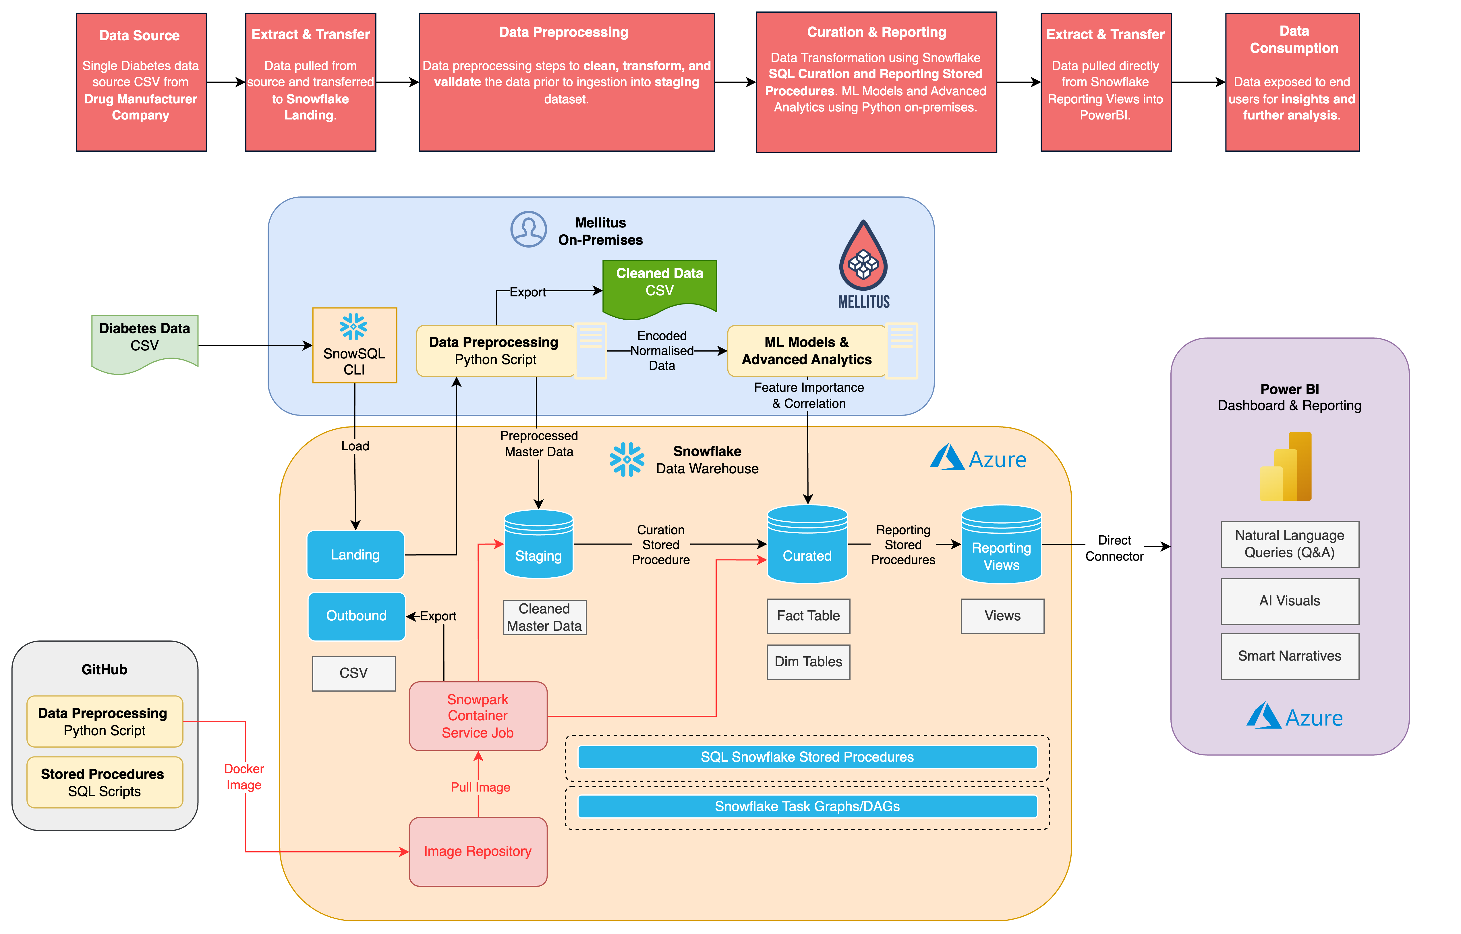
Deliverable 1 – Data preprocessing
Notes:
Ensure the titles are not duplicated. Please check the set of best practices.

Slide 17
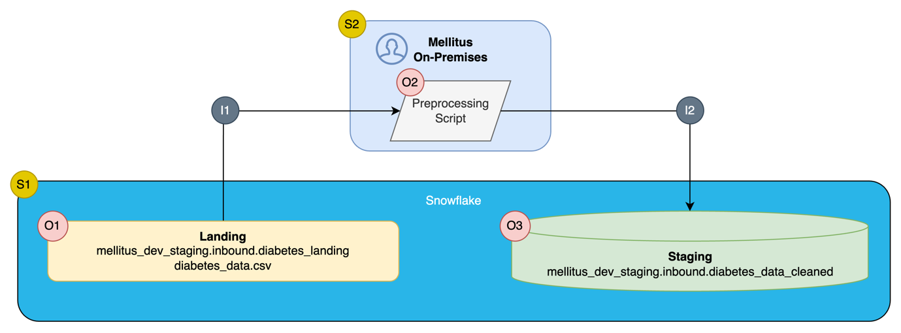
Deliverable 1 – Data preprocessing
ID | Type | Name | Description
S1 | System | Snowflake Data Warehouse | Stores all raw/cleaned/curated data for Mellitus (Diabetes Data)
S2 | System | Mellitus On-Premises | Runs Preprocessing Application
O1 | Object | Landing | File staging for inbound files
O2 | Object | Preprocessing Script | Set of python scripts for preprocessing
O3 | Object | Staging | Database staging for inbound data
I1 | Interface | Landing to Preprocessing | Data load from diabetes data file into DataFrame within preprocessing
I2 | Interface | Preprocessing to Staging | Data write into staging from preprocessing script
Notes:
Ensure the titles are not duplicated. Please check the set of best practices.

Slide 18
Deliverable 2 – EDA Report
 | Feature Importance - ML Model Ranking
Model | 1 | 2 | 3 | 4 | 5
Random Forest | weight | stress | alcohol | physical activity | bmi
XGBoost | family_diabetes | weight | alcohol | physical activity | stress
Logistic | family_diabetes | weight | stress | bmi | alcohol
Notes:
Ensure the titles are not duplicated. Please check the set of best practices.

Slide 19
Deliverable 3 – Cleaned and Prepared data CSV
• age_group
• bmi_group
• height
• imputed_columns
• gender_encoded
• diet_type_encoded
• physical_activity_level_encoded
• alcohol_consumption_encoded
• star_sign_encoded
• social_media_usage_encoded
• stress_level_encoded
• age_scaled
• diabetes_pedigree_function_scaled
• BMI_scaled
• weight_scaled
• sleep_duration_scaled
• pregnancies_scaled
• gender_encoded_scaled
• diet_type_encoded_scaled
• physical_activity_level_encoded_scaled
• alcohol_consumption_encoded_scaled
• star_sign_encoded_scaled
• social_media_usage_encoded_scaled
• stress_level_encoded_scaled
• predicted_diabetes_flag
• created_user
• created_dttm
• modified_user
• modified_dttm
• file_id
• row_id
• gender
• age
• hypertension
• diabetes_pedigree_function
• diet_type
• star_sign
• BMI
• weight
• family_diabetes_history
• social_media_usage
• physical_activity_level
• sleep_duration
• stress_level
• pregnancies
• alcohol_consumption
• diabetes
Notes:
Ensure the titles are not duplicated. Please check the set of best practices.

Slide 20
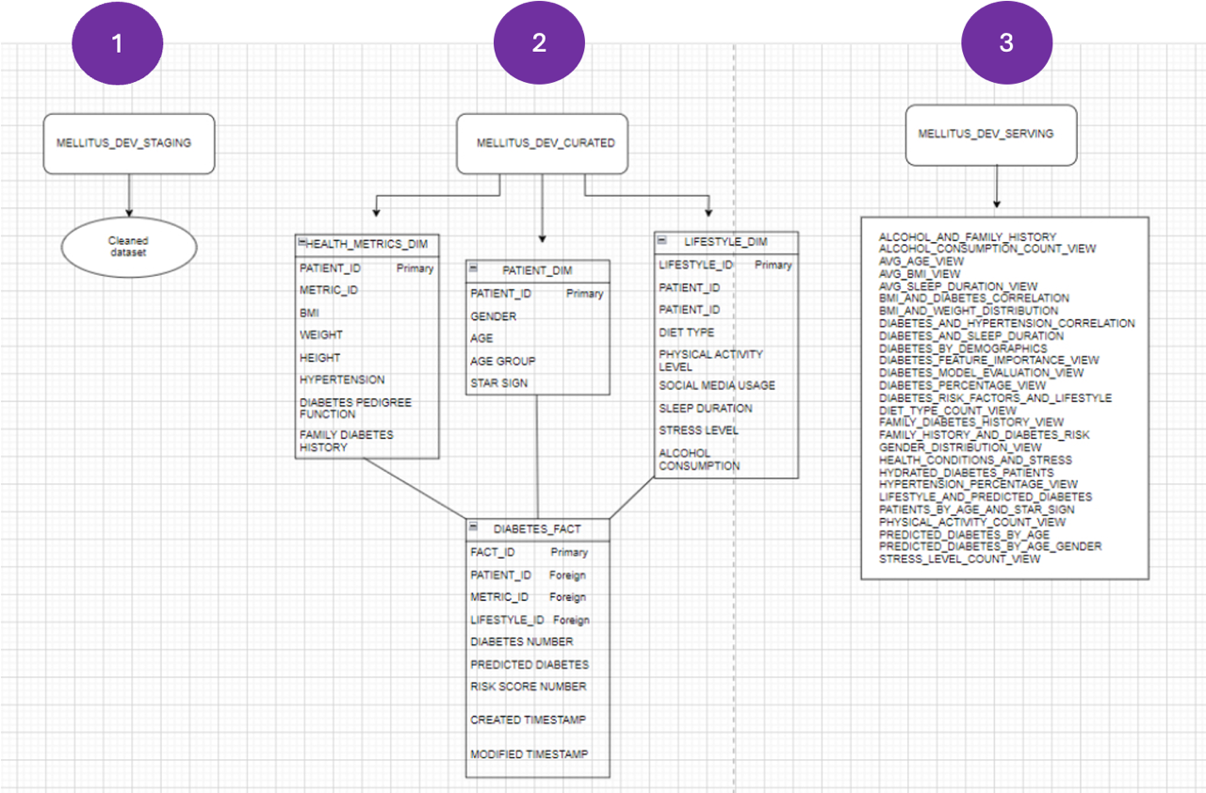
Deliverable 4 – Schema Design & SQL Queries
1.Staging Database: cleaned data loaded from CSV
2. Curated database: Star schema- central fact table with descriptive dimension tables.
3. Serving database: Views providing valuable insights for lifestyle management and prevention of diabetes.
Notes:
Ensure the titles are not duplicated. Please check the set of best practices.

Slide 21
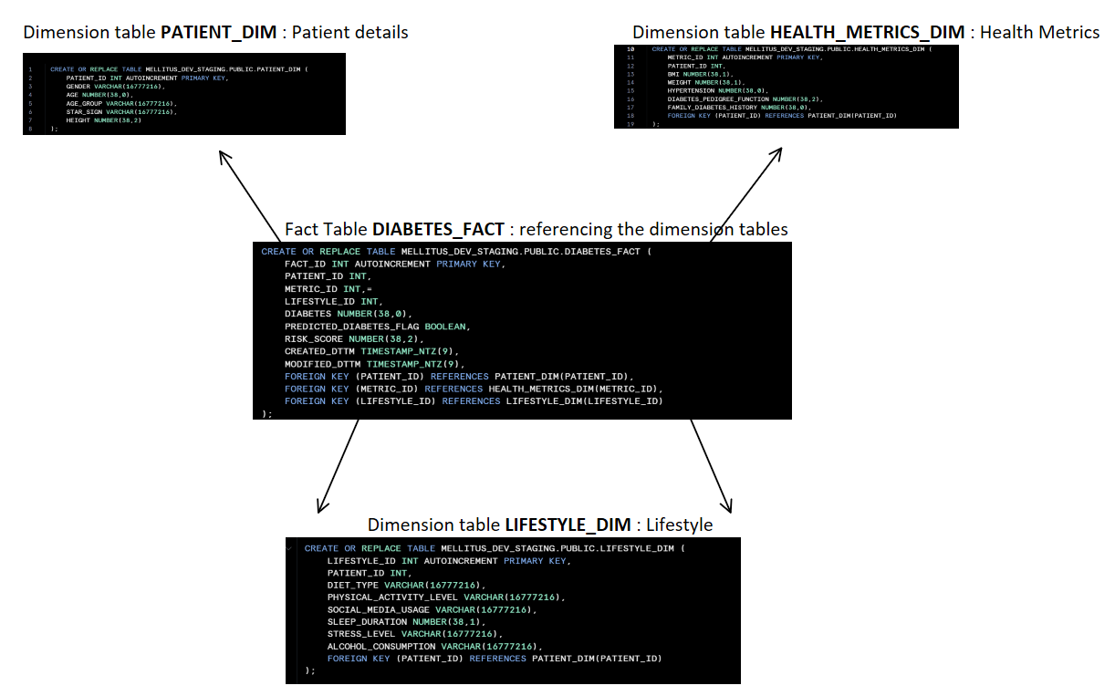
Why a star schema?
Simplified queries: fact table easily joins dimension tables together.
Improved performance: efficient joins
Data consistency
Enhanced analysis
Notes:
Ensure the titles are not duplicated. Please check the set of best practices
Simplified queries: fact table easily joins dimension tables together. Eg: easily joins patient dimension and health metrics

Slide 22
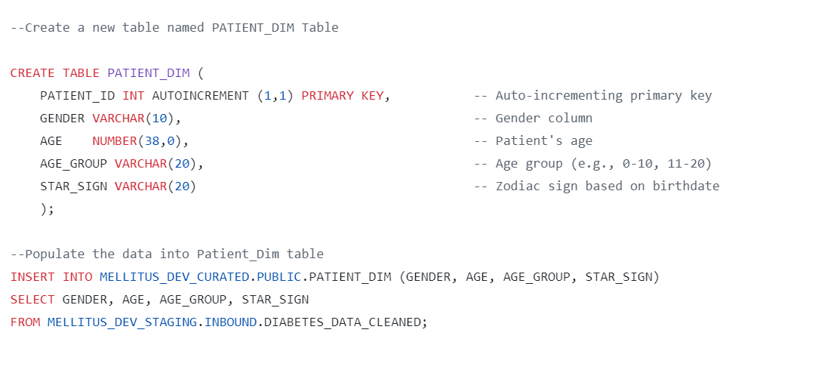
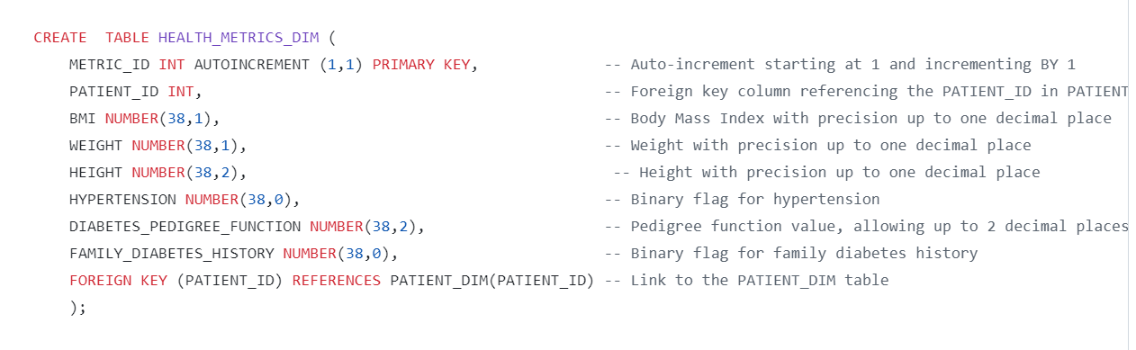
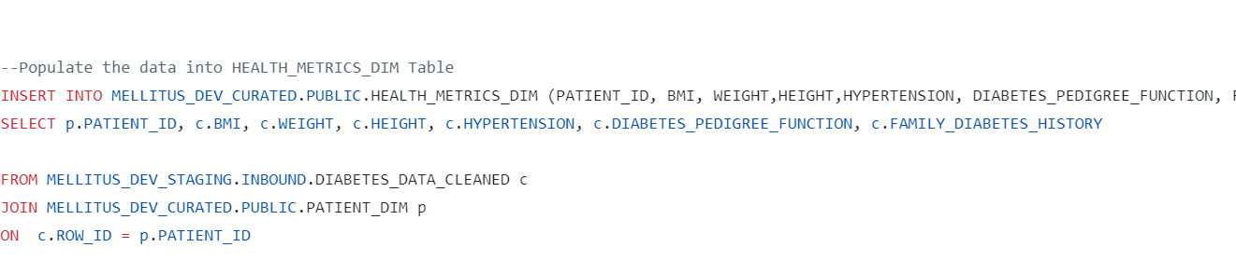
QUERIES(1)

Slide 23
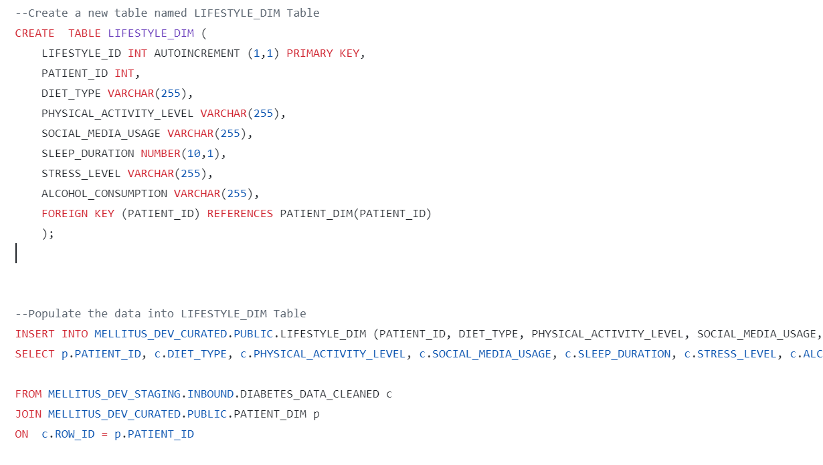
QUERIES (2)

Slide 24
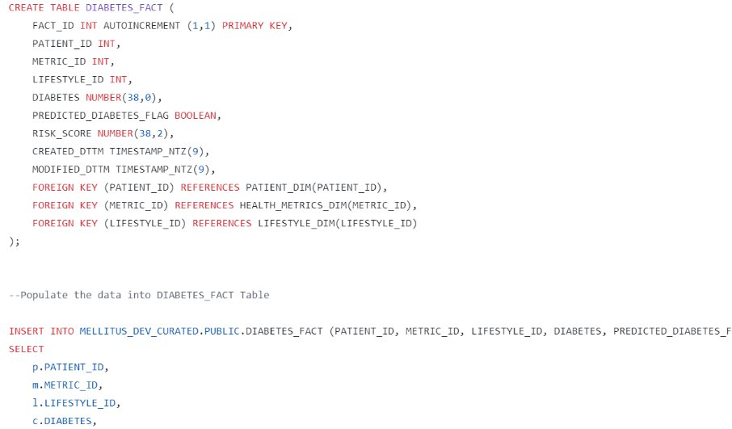
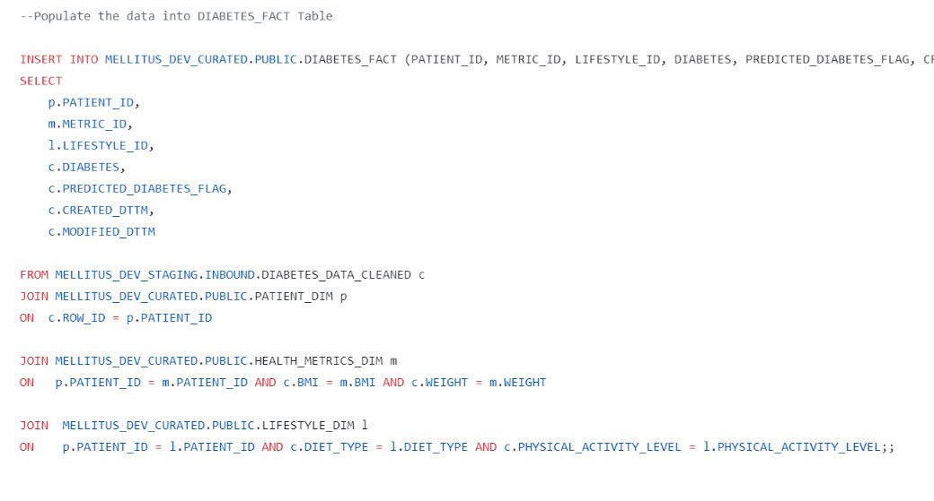
QUERIES (3)

Slide 25
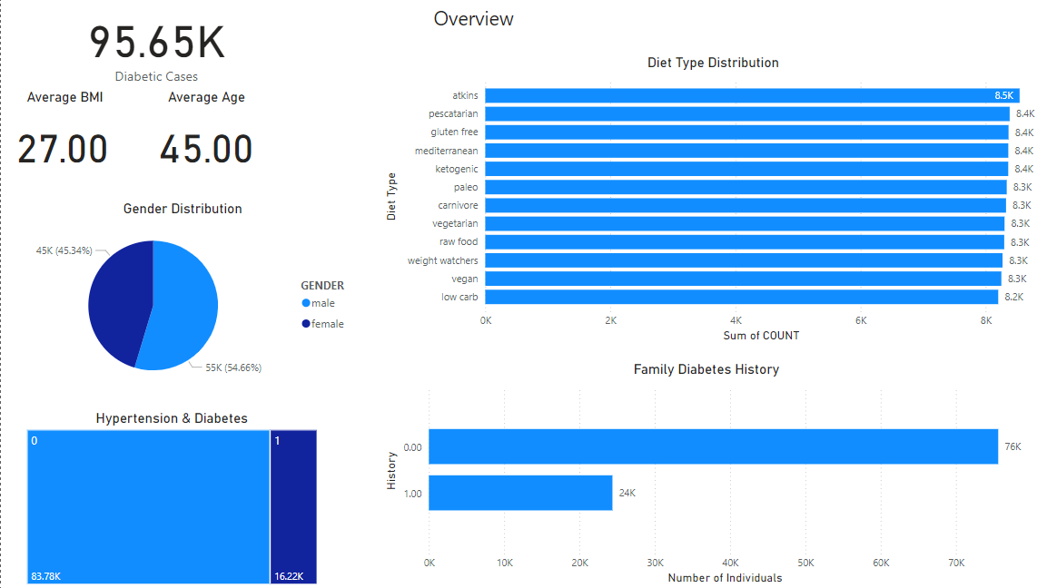
Deliverable 5 – Visualization Report
Notes:
Ensure the titles are not duplicated. Please check the set of best practices.

Slide 26
Visualisation Insights
From the visualisations, we have gathered that:
Out of 100,000 patients, 95.65% are diabetic. Out of this:
52,267 cases are male while 43,384 are female.
Heavy Alcohol Consumption is a key lifestyle factor, affecting 44.96% of diabetic cases whereas sedentary lifestyles is the most significant factor that contributes to the risk of diabetes.
Health Metrics:
• The average BMI of diabetic patients is 27, which is seen as overweight.
• 16.22% of diabetic patients also have hypertension, highlighting a compounded risk.
Demographics:
• Diabetes affects all age groups but is most predominant in middle-aged patients (45–64 years).
Having family history of diabetes also contributes to diabetes, with 24% of cases being linked to genetics.
Key Risk Factors:
• The top predictors of diabetes are physical activity level, BMI, stress, family history of diabetes, and alcohol consumption.
Impact on the body:
High BMI, combined with diabetes increases the risk of heart disease or strokes.
Elevated stress levels risk damaging nerves, leading to reduced mobility.
Diabetes can also bring kidney damage, and in severe cases, kidney failure.
Diabetes leads to conditions in the eyes like cataracts, glaucoma, which can lead to vision loss.
Diabetes increases the risk of infections which can lead to serious consequences such as amputation
Diabetes is also associated with higher rates of depression and anxiety.

Slide 27
Technical difficulties (For potential question in Q&A)
Please note this is a placeholder to illustrate technical difficulties we encountered
Notes:
Ensure the titles are not duplicated. Please check the set of best practices.

